Slide 1
Parking-Lot Occupancy Tracking
Shady Boukhary and Jesse Houk
With
Dr. Terry Griffin
Midwestern State University

Slide 2
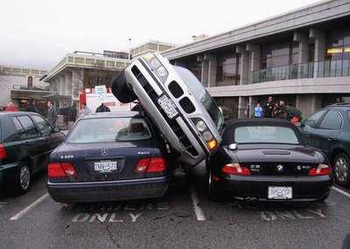

Problem
Late for class … again.

Slide 3
Motivation
Available parking spaces are elusive.
Location Based Services are easy to implement.
Identifying available parking is not easy to implement, but possible, and has an expressed need.

Slide 4
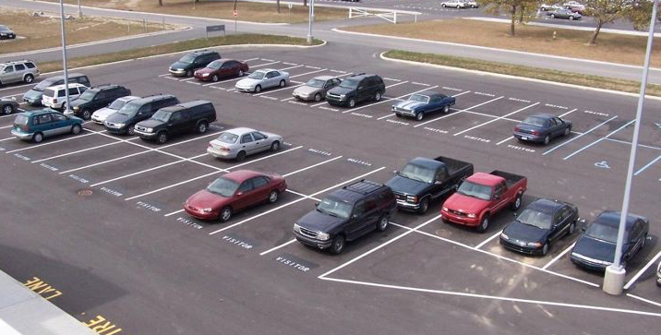
Overview
Identifying Available Parking Spaces has three stages:
Automatic parking space discovery
Identifying spaces as available
Mobile application showing results

Slide 5

Some Terminology
Edge Detection
Line Detection
Corner Detection
Object Detection
Filtering
Color Identification
Notes:
All detections done with Canny Edge Detection with OpenCV
Filtering gives idea of using an image which also is why we use a CNN
Color ID refers to R, G, B values of a pixel of an image and associating them to determine some existance

Slide 6


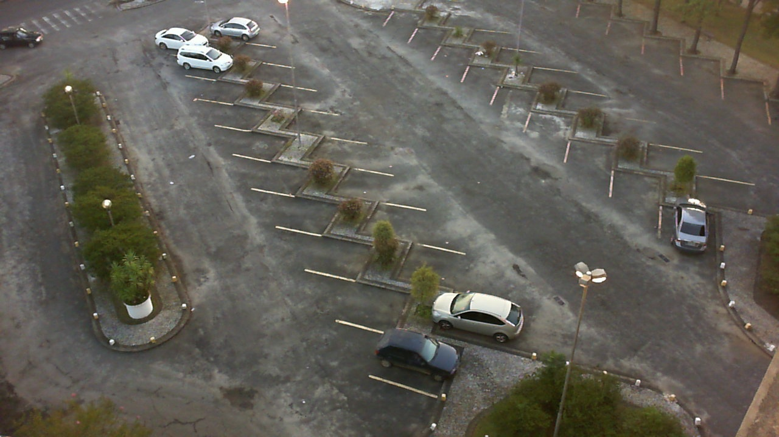








































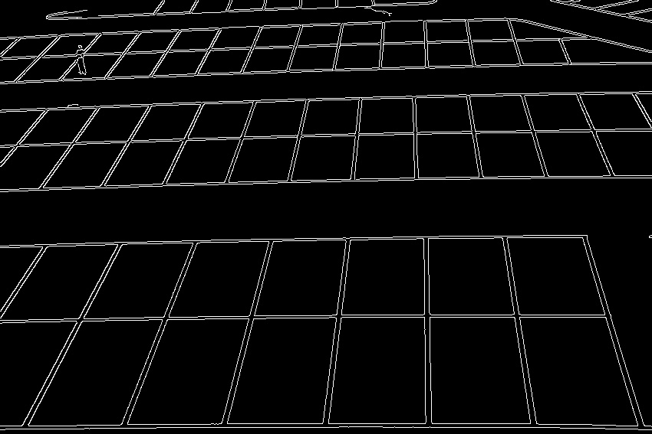

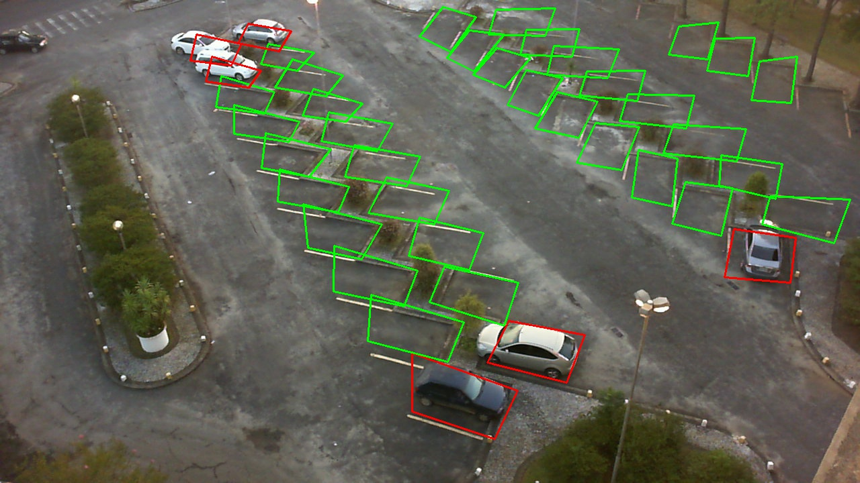



Application
( filters )
Original
Individual Spot Masking
Edged
Closed
Notes:
P-L-O-T/EXPERIMENT-1
Individual Spot Masking needs uniformity and organization (Current: Bottom left going up then right is 1, 2, 3, …, 40)
Edged needs rest of pictures and “ ”

Slide 7
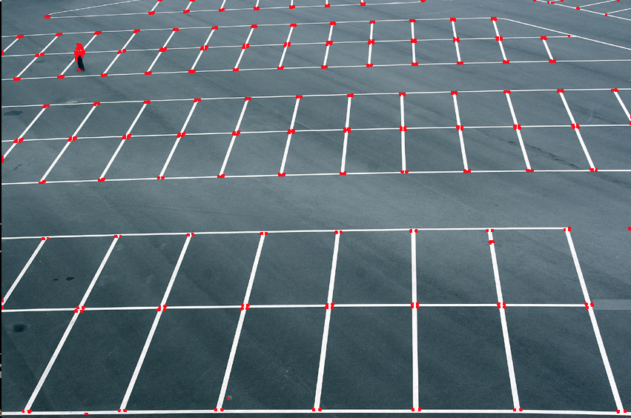
Application
( Corners)
Corner Detection

Slide 8
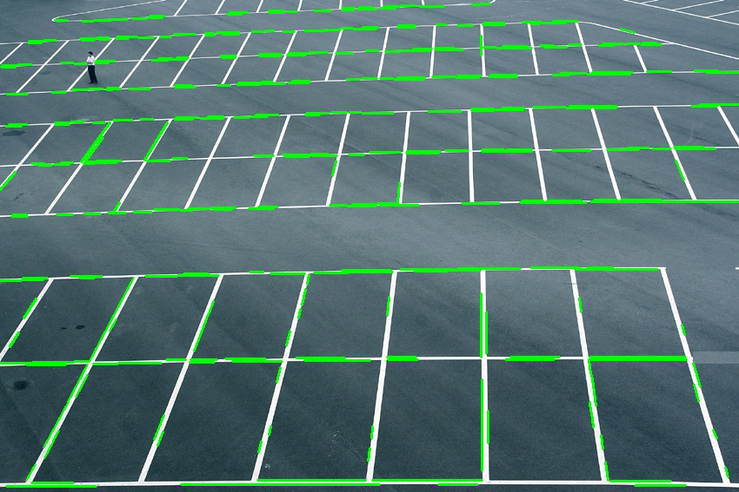
Application
( Lines)
Line Detection

Slide 9
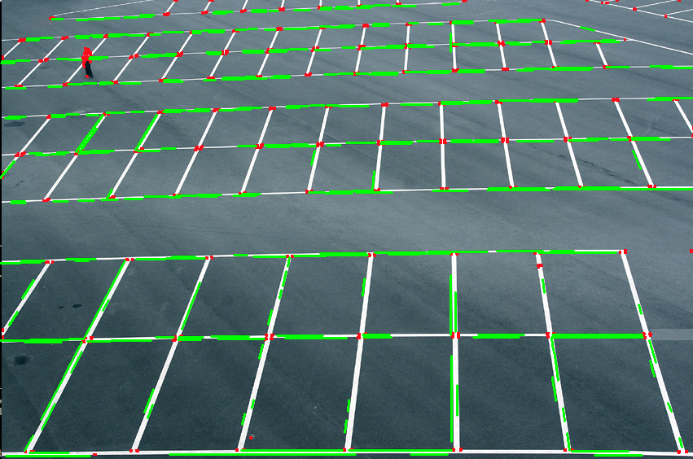
Application
( Lines and Corners)

Slide 10
Problems
A real time robust parking space identification algorithm is possible, but not 100%
We choose to move to Stage 2
Automatic parking space discovery
Identifying spaces as available
Mobile application showing results

Slide 11
Sources
http://cs231n.github.io/convolutional-networks/ (filters image)

